Slide 1

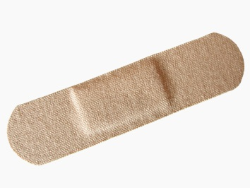



Annual Review of Required Topics
Lawrence County Cooperative School presents:
Notes:
[Note to trainer: For detailed help in customizing this template, see the very last slide. Also, look for additional lesson text in the notes pane of some slides.]

Slide 2
Course contents
Overview: DDS Training Requirements
Lesson 1: Required Topics
Lesson 2: Overview of Federal and State Laws
Post Test
Each lesson will review the required topics and the conclusion will be a test over the information that has been presented.

Slide 3
Overview: DDS Training Requirements
DDS standards state that all employees are required to have 12 hours of training or more based on job title of training annually and also an annual review of topics that are specified by DDS.
The information in this training module is designed to educate you on the topics that are required in the Annual Review.

Slide 4
What is the goal?
The goal of this course is to effectively educate the employees of the Lawrence County Cooperative School on the required training topics set by DDS.
***Keep in mind as you review the following information on these topics it allows you, as an employee, to be more successful and educated in your position.

Slide 5
Required Topics
Lesson 1
First Aid
First Aid must be reviewed annually and renewed every three years.
***First Aid Kits are provided in vans when transporting & in each emergency kit provided for disasters.
Notes:
In this lesson, get comfortable with typing onto slides, arranging text, adding new slides, and navigating in the PowerPoint® window. Then see how to prepare notes as you create the show to refer to when you present.
Note: If you want the super-fast method of creating a show—that is, the cake mix instead of the simple cake recipe from scratch—use the AutoContent Wizard. Steps for it are in the Quick Reference Card at the end of the course. By contrast, this course's lessons show you how to do all the basic stuff yourself.

Slide 6
FIRST AID - REFRESHER
First aid is the initial basic treatment of an injured or ill person. First aid requires an observer first to evaluate the injured or ill person and then to intervene,.
(Below are some Cases for First Aid)
Bites and Scratches
Bleeding
Broken Bones, Sprains, and Strains
Bug Bites and Stings
Burns
Choking
Fever
Nosebleeds
Seizures
Vomiting

Slide 7
FIRST AID (Cont.)
ANIMAL BITES
INSECT STINGS AND BITES
Animal bites and scratches that break the skin can sometimes cause infection. Some may need to be closed with stitches but many heal on their own. Rarely, animal bites (especially from wild animals) can lead to rabies, a life-threatening disease.
What to do:
  Wash the bite with soap and water and apply pressure with sterile gauze or cloth if bleeding.
  Apply antibiotic ointment when bleeding stops.
  Cover with bandage or sterile gauze.
  Offer ibuprofen for pain.
Seek Medical Attention if:
  The bite was from: wild or stray animal, animal not up to date on rabies shot, or animal acting strangely.
  Bite has broken skin
  Bite is on the face, head, neck, hand, foot, or near a joint.
  Bite becomes red, hot, swollen, or increasingly painful.
  Person is behind on shots or has not had a tetanus shot within 5 years.
Although insect stings and bites can be irritating, symptoms usually begin to disappear by the next day. However, people who are allergic to some insect stings or bites may sometimes have life-threatening symptoms requiring emergency treatment.
Signs and symptoms:
  Mild reaction: red bumps, itchiness, and mild swelling.
  Severe reaction: swelling of the face or mouth, difficulty swallowing or speaking, chest tightness, wheezing, difficulty breathing, dizziness, or fainting.
What to do :
  Mild reaction:
    Remove stinger if it is visible by scraping skin horizontally with the edge of credit card or your fingernail.
    Wash with soap and water
    Apply ice or cool wet cloth to relieve pain
  Severe reaction:
    Call 911
    If they have an EpiPen, that should be given
Seek Medical attention if:
Sting is inside or near mouth, person has allergy, EpiPen was used, or if the site looks infected.

Slide 8
FIRST AID (Cont.)
BROKEN BONES
STRAINS AND SPRAINS
Broken bones or fractures are common injuries especially after a fall. No matter what part might be broken or how big or small the injury may seem, all broken bones need medical care.
Signs & Symptoms:
  You hear a “snap” or grinding during the injury
  There’s swelling, bruising, or tenderness
  The injured part is difficult to move or hurts when moving, being touched, or bearing weight.
What to do:
  Remove clothing from the injured area.
  Apply ice pack wrapped in cloth
  Keep injured limb in the position you find it.
  Place a simple splint, if you have one, on the broken area.
  Get medical care, don’t let them eat in case surgery is req’d.
Do Not Move the Person and Call 911 Right Away If:
  You suspect a serious injury the head, neck, or back.
  A broken bone comes through the skin. While waiting for help: Keep the person laying down, and do not wash the wound or push in any part that’s sticking out.
Strains are injuries due to overstretching, while sprains involve a stretch or a partial tear of ligaments or tendons.
Signs & Symptoms:
  Pain in the joint or muscle
  Swelling and bruising
  Warmth and redness of the injured part
  Difficulty moving the injured part
What to do:
  Stop activity right away.
  Think R.I.C.E. for the first 48 hours after injury:
  Rest: Rest injured part
  Ice: wrap icepack over injured part. No more than 20 mins. at a time, four to eight times a day.
  Compression: support injured part w/ elastic bandage .
  Elevation: raise injured part above heart level .
Seek Emergency Medical Care If:
  severe pain when injured part is touched or moved , continued trouble bearing weight, increased bruising, numbness, signs of infection, or strain or sprain that does not improve within 5 to 7 days .

Slide 9
FIRST AID (Cont.)
BURNS
FEVER
Scald burns from hot water and other hot liquids are the most common burns. Since burns range from mild to life threatening, some can be treated at home, while others need emergency medical care.
What to Do :
  If the person is severely burned, call 911 right away, while you wait begin these treatments:
  Remove clothing from burnt area, except stuck clothing.
  Run cool (NOT COLD) water over the burn.
  Offer something for pain.
  Do not apply ointment on burn or break blisters!!
Seek Emergency Medical Care If:
  The burned area is large (cover the area with a clean, soft cloth or towel)
  The burns came form a fire, an electrical wire or socket, or chemicals.
  The burn is on the face, hands, joints, or genitals.
  The burn looks infected (with swelling, pus, or increasing redness or red streaking of the skin near the wound).
Although it can be frightening when a child’s temperature rises, fever itself causes no harm and can actually be a good thing, it’s often the body’s way of fighting infections.
Signs & Symptoms:
  A child may have a fever if he or she is:
  Fussy, uncomfortable, warm to the touch, flushed, or sweaty.
What To Do: It’s best to keep a child with a fever home from school or childcare. If your child is uncomfortable due to fever, here are some ways to relieve symptoms::
  Offer plenty of fluids to avoid dehydration.
  Ask a doctor about fever-reducing medicines.
  NEVER use rubbing alcohol to bring fever down.
  DO NOT give aspirin to an infant or child.
SEEK MEDICAL CARE RIGHT AWAY IF:
  An infant is younger than 3 months and has a temp of 100.4 or higher.
Call the doctor if an older person has a fever and also, appears sick, has a rash, has persistent diarrhea or vomiting, has signs of dehydration, recurring fevers for 5 days, has a chronic medical problems like, sickle cell disease, heart problems, cancer, or lupus.

Slide 10
FIRST AID (Cont.)
NOSEBLEEDS
CHOKING
Although they can be scary, nosebleeds are common and usually aren’t serious. Most stop on their own and can be treated safely at home. Nosebleeds occur more often in winter and when the air is dry.
What to Do:
  Have the person sit up with his or her head tilted slightly forward. DO NOT HAVE THE PERSON LEAN BACK (this may cause gagging, coughing, or vomiting)
  Pinch the soft part of the nose (just below the bony part) for at least 10 minutes.
Seek Medical Care if the Person:
  Has frequent nosebleeds
  May have put something in his or her nose
  Tends to bruise easily
  Recently started a new medication
Seek Emergency Medical Care if Bleeding:
  Is heavy
  Is accompanied by dizziness or paleness
  Continues after two or three attempts of applying pressure for 10 minutes each
  Is the result of a blow to the head or fall
Chocking can be a life-threatening emergency. A person might be choking if he or she suddenly: begins gasping or wheezing, cant talk, cry or make noise, begins to turn blue in the face, grabs at their throat or waves arms, or appears panicked.
If a person is choking, call 911 right away, or have someone else call. If you are trained to do the Heimlich Maneuver, do it immediately.
Do not reach into the mouth to grab the object or pat them on the back. Either could push the object farther down the airway and make the situation worse.
Keep the following in mind:
  If a person is gagging and coughing but can breathe and talk, the airway is not completely blocked and it’s best to do nothing. They will likely be fine after the coughing spell.
  If the person was choking and is now unconscious and no longer breathing, call for help and then immediately perform CPR, if you’ve been trained.
  Take the person for medical care after any serious choking episode, especially if there is a persistent cough or wheezing. If the person is having difficulty breathing or swallowing, go to the emergency room.

Slide 11
FIRST AID (Cont.)
SEIZURES
VOMITING
Although seizures can be frightening, many last only a few minutes, stop on their own, and are almost never life-threatening. Seizures can take many forms, from staring spells to involuntary movements of the arms and legs.
Signs an symptoms may include: unusual sensations or twitching before seizure, uncontrollable muscle spasms, loss of consciousness, and/or uncontrolled urination or bowel movement.
What To Do: Some seizures require immediate medical care while others can be managed at home. If a person has a seizure:
  Gently place on floor and remove nearby objects.
  Loosen clothing around neck.
  Do not try to prevent shaking.
  Do not put anything in their mouth or roll onto side.
  Let them rest after seizure and call their doctor.
  Seek emergency medical care or call 911 if:
  seizure last longer than 5 mins . or having repeated seizures
  Has difficulty breathing or bluish color on lips or face
  Remains unconscious for more than a few mins.
  Falls and hits their head before or during a seizure
  Seems to be ill or has any symptom that concerns you.
Vomiting can be caused by many things, most commonly the “stomach flu”. Vomiting can cause you to lose fluids, salts, and minerals, so it is important to make sure these are replaced.
What To Do:
  Do not feed milk products and solids.
  Give small amounts of fluids. IF they vomit again, wait 20-30 minutes and start over.
  Gradually increase the amount of fluids once there’s no vomiting for 3 to 4 hours.
  After 8 hours without vomiting, serve bland foods such as rice, applesauce, toast, crackers, and cereal.
  Resume regular diet after 24 hours without vomiting. Call a doctor if it starts again.
Seek Medical Care If: vomiting is accompanied by,
  Signs of dehydration
  Inability to keep clear fluids down
  Vomit that is greenish-yellow or has blood in it
  Hard, bloated, or painful belly
  Extreme irritability
  Swelling, redness, or pain in a boy’s scrotum
  Projectile or forceful vomiting in a newborn

Slide 13
Issues Regarding Prevention of Acquired Immunodeficiency Syndrome (AIDS), Hepatitis B (HIV) and/or other Blood Borne Pathogens and the application of Federal Civil Rights Laws to persons with AIDS or HIV related condition for those who may be perceived to have AIDS or HIV related conditions
Part I
Prevention Strategies
Use of barriers (such as gloves and/or goggles) when anticipating contact with blood or body fluids
Washing hands and other skin surfaces immediately after contact with blood or body fluids
Careful handling and disposing of sharp instruments during and after use
*Always assume that the blood and other body fluids from all people are potentially infectious
Notes:
You can also press the PAGE UP or PAGE DOWN key to navigate.

Slide 14
Issues Regarding Prevention of Acquired Immunodeficiency Syndrome (AIDS), Hepatitis B (HIV) and/or other Blood Borne Pathogens and the application of Federal Civil Rights Laws to persons with AIDS or HIV related condition for those who may be perceived to have AIDS or HIV related conditions
(Con’t)
Part II
Your Rights as a Person with HIV Infection or AIDS:
The office for Civil Rights of the U.S. Department of Health and human Services enforces federal laws that prohibit discrimination by health care and human service providers.
Two of the laws are Sections 504 or the Rehabilitation Act of 1973 (“Section 504”) and Title II of the Americans with Disabilities Act of 1990 (“ADA”).
Notes:
Suggestion: Use notes to embellish or elaborate on the points on the slide. This helps you keep from overloading the slide, and your audience, with text.
Warning and tip: If your notes exceed the space on the notes page, they will get cut off when you print. To prevent this, you can:
Change the layout of the notes page.
Send the presentation to Microsoft Word before printing.
Both these methods are detailed in the Quick Reference Card.

Slide 15
Issues Regarding Prevention of Acquired Immunodeficiency Syndrome (AIDS), Hepatitis B (HIV) and/or other Blood Borne Pathogens and the application of Federal Civil Rights Laws to persons with AIDS or HIV related condition for those who may be perceived to have AIDS or HIV related conditions
(Con’t)
Both Section 504 and the ADA prohibit discrimination against qualified persons with HIV and other disabilities. Section 504 prohibits discrimination by health care and human service providers that receive federal funds or some other types of federal assistance. Title II of the ADA prohibits discrimination by state and local government entities even if they do not receive federal financial assistance. Examples of entities that may be covered by 504 and the ADA include hospitals, CLINICS, social services agencies, drug treatment centers and nursing homes.

Slide 16
Issues Regarding Prevention of Acquired Immunodeficiency Syndrome (AIDS), Hepatitis B (HIV) and/or other Blood Borne Pathogens and the application of Federal Civil Rights Laws to persons with AIDS or HIV related condition for those who may be perceived to have AIDS or HIV related conditions
( Con’t)
Discrimination may occur if the entity excludes a person with HIV from participating in a service or denies them a benefit. The person living with HIV must meet the essential eligibility requirements for the benefit or service he or she is seeking. The entity may be required to make a reasonable accommodation to enable the person with HIV to participate. The ADA also protects other persons, such as family and friends who are discriminated against because of their association with someone who has HIV.
Persons with HIV infection have been denied access to social services, or denied medical treatment or had treatment or services delayed solely because they have HIV or AIDS.
Notes:
[Note to trainer: With PowerPoint 2003 installed on your computer, you can click the link in the slide to go to an online practice. In the practice, you can work through each of these tasks in PowerPoint, with instructions to guide you. Important: If you don’t have PowerPoint 2003, you won’t be able to access the practice instructions.]

Slide 17
Issues Regarding Prevention of Acquired Immunodeficiency Syndrome (AIDS), Hepatitis B (HIV) and/or other Blood Borne Pathogens and the application of Federal Civil Rights Laws to persons with AIDS or HIV related condition for those who may be perceived to have AIDS or HIV related conditions
(Con’t)
Please visit the Department of Health and Human Service website @ www.dhhs.gov for more information regarding “Your Rights as a Person with HIV or AIDS”
The website has more in depth information regarding the types of discrimination against persons with HIV/AIDS.
Also on the website you will find a link on how to file a complaint if you believe you have been discriminated against.

Slide 18
DDS Administrative Policy, Chemical Right to Know
The purpose of the Chemical Right to Know is to ensure that the hazards of all chemicals produced or imported are evaluated and that information concerning their hazards is transmitted to employers and employees. This transmittal of information is to be accomplished by means of comprehensive hazard communication programs, which are to include container labeling and other forms of warning, material safety data sheets (MSDS) and employee training.
LCCS has a “OSHA Hazard Communication Packet A/K/A Chemical Right to Know” book. To review the complete book, please contact LCCS.

Slide 19
OSHA
LCCS/HH will provide PPE (personal protective equipment) example: gloves, face shield/goggles, apron, mittens
Sharps containers to be placed in Main Offices of Adult Bldg, PS Bldg, Main Office Bldg, and Haynes House.
*Some of the procedures will vary based on department setting. Example: center vs residential facility
Notes:
19
You can also press the PAGE UP or PAGE DOWN key to navigate.

Slide 20
OSHA- cont’d
PPE Used for Specific Jobs:
Job PPE Req’d
-shots by competent adults ……………………………..…gloves, covered case
-clean-up of blood ……………………………….………….gloves, face shield/goggles
-rinsing/washing out blood-containing clothes & linens………………gloves, face shield/goggles
-cleaning equipment with blood on it……..…… gloves, face shield/goggles
place bag labeled in BIO in RED …………….…..gloves, apron, face shields/goggles
-changing diapers……………………………………...gloves, face shield/goggles
-cooking………………………………...…………………mittens, gloves
Notes:
20
You can also press the PAGE UP or PAGE DOWN key to navigate.

Slide 21
OSHA- cont’d
Housekeeping:
A 1:10 solution of bleach and water, mixed daily is to be used to clean and decontaminate surfaces and equipment.
Schedule for cleaning and decontamination is:
Area on Equipment Cleaning Frequency
Floors in bathrooms & laundry weekly
Changing tables after every use
All trash cans weekly
Medication cabinets after every use
Notes:
21
You can also press the PAGE UP or PAGE DOWN key to navigate.

Slide 22
OSHA-cont’d
Hazard Communication Program
- MSDS (Material Safety Data Sheets)
are located in the main/HH office
*At no time, should a chemical at the time of shipment/purchase be accepted without a MSDS to be turned into office to be filed for emergencies.
Also any containers being used from another product/chemical must be labeled with laundry marker specifying its chemical name & its product name.
Notes:
22
You can also press the PAGE UP or PAGE DOWN key to navigate.

Slide 23
Crisis Response
Plan
Emergency Procedures and Evacuation Preparedness
Notes:
23
You can also press the PAGE UP or PAGE DOWN key to navigate.

Slide 24
Crisis Response Plan
LCCS will call 911/ access necessary emergency agencies for evacuation routes. Emergency lighting is in the Preschool, Adult, and Residential Housing. All other doors have Exit Signs. This information is in addition to the Crisis Response Book that was given to you.
FIRE:
Contain the fire is possible (i.e. close the doors).
Stay low in a burning building, away from smoke and toxic fumes.
Check doors before opening; do not open a door that feels hot.
If your clothing catches fire – stop, drop, and roll.
EARTHQUAKE:
If you are outside, get away from buildings, utility poles, and trees.
If you are driving, avoid bridges and overpasses.
If you smell gas, open a window and leave.
When things are safe, inspect water pipes and electrical lines.
Tune into radio or TV for the latest emergency information.
BOMB THREAT:
Be calm, courteous and listen. Do not interrupt the caller when he or she is speaking. But when the caller stops talking, ask questions to get additional information to complete the Bomb Threat Checklist in Crisis Response Plan.

Slide 25
Violence in the Workplace
This information is in addition to the Crisis Response Book that was given to you.
There is a zero tolerance policy for violence in the workplace at LCCS.
All employees have a background check upon hire.
No one is allowed to go through center without a pass. Cameras are installed in different locations as an added measure.
If a threat has been made inside or outside our facility, local authorities will be notified.
NO threat will be ignored.
Below are some factors that could serve as warning signs or red flags:
Does not take criticism well, may have contempt for their boss.
Externalizes blame, never assumes responsibility for problems.
Paranoid, views change as a personal affront.
Pushes the limits of normally acceptable conduct.
A substance abuser – could be alcohol or drugs.
A domestic abuser or victim of abuse.
There are many more that could be likelihood of committing a violent act.

Slide 26
Overview of Federal and State Laws
Ark. Code Ann. 25-2-104, 25-2-105, 25-2-107
Arkansas Department of Human Services Reorganization
In 1985 the Arkansas Legislature authorized the reorganization of the DHS in order to accomplish two things:
To establish an integrated service system with a base in each Arkansas County
To clarify the responsibility for the operation and management of institutional programs under the control of the state hospital board, the state board of Developmental Disabilities Services and the Arkansas Youth Services Board

Slide 27
Overview of Federal and State Laws
Ark. Code Ann. 25-10-102-25-10-116
DHS Reorganization
The Department of Health and Human Services shall consist of and be operated under an integrated service system consisting of the following twelve (12) divisions with responsibility and programs assigned to them as determined by the Director of the Department of Health and Human Services:
(1) A Division of Aging and Adult Services;
(2) A Division of Medical Services;
(3) A Division of Behavioral Health, which shall include community mental health centers, state hospitals, and the Bureau of Alcohol and Drug Abuse Prevention;
(4) A Division of Developmental Disabilities Services, which shall include both community programs and human development centers;
(5) A Division of County Operations;
(6) A Division of Administrative Services;
(7) A Division of Youth Services, which shall include serious offender and community-based programs and the youth service centers;
(8) A Division of Volunteerism;
(9) A Division of State Services for the Blind;
(10) A Division of Children and Family Services;
(11) A Division of Child Care and Early Childhood Education; and
(12) A Division of Health.
(b)(1)(A) Each division of the Department of Health and Human Services shall be under the direction, control, and supervision of the director.
(B) From time to time, the director may transfer or assign existing duties or new programs or duties of the department to offices, sections, or units as he or she deems necessary for the efficient and necessary operation of the department.
(C) Prior to implementation of any reorganization, the director shall obtain the advice of the House Interim Committee on State Agencies and Governmental Affairs and the Senate Interim Committee on State Agencies and Governmental Affairs.
(2)(A) However, the state institutions and the operation of state institutional programs under the jurisdiction of the Board of Developmental Disabilities Services and the Department of Health and Human Services State Institutional System Board, as provided by law, shall be under the control of their respective boards.
(B) The boards shall perform their respective functions and duties under the general guidelines and standards promulgated by the director.
(3) The Division of State Services for the Blind and the Board of the Division of State Services for the Blind shall continue to function within the Department of Health and Human Services with the powers prescribed in § 25-10-201 et seq.

Slide 28
DHS ORGANIZATIONAL CHART
GOVERNOR
DHS DIRECTOR
DIVISION OF VOLUNTEERISM
OFFICES OF CHIEF OFFICES
DIVISION OF AGING & ADULT SERVICES
DIVISION OF MEDICAL SERVICES
DIVISION OF ADMINISTRATIVE SERVICES
DIVISION OF STATE SERVICES OF THE BLIND
DIVISION OF DEVELOPMENTAL DISABILITIES SERVICES
DIVISION OF CHILDREN & ADULT SERVICES
DIVISION OF MENTAL HEALTH SERVICES
DIVISION OF YOUTH SERVICES
DIVISION OF COUNTY OPERATIONS
DDS BOARD
HUMAN DEVLOPMENT CENTERS
COUNTY OFFICES

Slide 29
DEVELOPMENTAL DISABILITIES ORGANIZATIONAL CHART
GOVERNOR
DIRECTOR DEPARTMENT OF HUMAN SERVICES
DIVISION DIRECTOR DEVELOPMENTAL DISABILITIES SERVICES
BOARD DEVELOPMENTAL DISABILITIES SERVICES
ASSISTANT DIRECTOR CLIENT SERVICES
ASSISTANT DIRECTOR PROGRAM MANAGEMENT
ASSISTANT DIRECTOR ADMINISTRATIVE SUPPORT
HUMAN DEVELOPMENT CENTERS
FIELD SERVICES
EARLY INTERVENTION (PART H)
SPECIAL EDUCATION SERVICES
GRANTS ADMINISTRATION
RESOURCE DEVELOPMENT (MEDICAID)
WAIVER
LICENSURE & STANDARDS
POILCY DEVELOPMENT &IMPLEMENTATION
WAIVER

Slide 30
History, Philosophy Goals, Program Practices, Policies, and Procedures of Local Organization
As an employee of LCCS, you should have some understanding of the people with disabilities. The DDS tapes you have seen in the past has also given you history of treatment approaches used in the past. Lets discuss three questions below.
What treatment approaches have been used with people with disabilities in the past?
What service approaches have been provided to people with disabilities in Arkansas?
3. What are some causes and types of Developmental Disabilities?
Notes:
30

Slide 31
History, Philosophy Goals, Program Practices, Policies, and Procedures of Local Organization
What treatment approaches have been used with people with disabilities in the past?
Looked as “different” and treated in ways that reflected fear and shame.
People who were sick, physically or mentally defective, or elderly were often left to perish, were killed, or sent far away where they generally died from lack of care.
Not until 19th century that we began to learn that people with disabilities could be educated to improve the quality of their lives. Then 1950’s and 60’s two major influences brought about a remarkable change in the care and habilitation of people with severe disabilities. A second movement, in the 70’s. Society is beginning to recognize that people with disabilities have abilities and they have the same basic needs common to us all.
Notes:
31

Slide 32
History, Philosophy Goals, Program Practices, Policies, and Procedures of Local Organization
What service approaches have been provided to people with disabilities in Arkansas?
Not until 19th century that we began to learn that people with disabilities could be educated to improve the quality of their lives. Then 1950’s and 60’s two major influences brought about a remarkable change in the care and habilitation of people with severe disabilities. A second movement, in the 70’s. Society is beginning to recognize that people with disabilities have abilities and they have the same basic needs common to us all.
More options available: Early Intervention, Preschool and Adult Habilitation, community-based living arrangements (ACS Waiver), supported employment, HDC (Human Development Centers) and self-contained classrooms in public schools, etc.
Notes:
32

Slide 33
History, Philosophy Goals, Program Practices, Policies, and Procedures of Local Organization
What are some causes and types of Developmental Disabilities?
Most causes of disabilities can be attributed to a biological or medical condition, and psychosocial conditions.
History of certain disabilities in a family household for example malnutrition during pregnancy can produce severe problems, including mental retardation, in the baby. And, diseases during pregnancy, particularly rubella, can cause serious disabilities in the newborn. Other signs of an at-risk pregnancy include: birth of a previous child with a chromosomal abnormality; alcohol or drug use during pregnancy, mother over age 35, can give birth to more than 33% of all down syndrome babies, mental retardation in the mother, many more.
Although hundreds of medically related causes of severe disabilities have been identified, in many cases the cause of a child’s disabilities cannot be clearly determined. Severe handicaps are usually considered to be less closely associated with socioeconomic status than are milder handicaps..
Notes:
33

Slide 34
WHAT IS MENTAL RETARDATION?
Mental Retardation is a term used when a person has certain limitations in mental functioning and in skills such as communicating, taking care of him or herself, and social skills.
Mental Retardation is diagnosed by looking at two main things: These are:
The ability of a person’s brain to learn, think, solve problems, and make sense of the world (called IQ or intellectual functioning); and
Whether the person has the skills he or she needs to live independently (called adaptive behavior, or adaptive functioning). People scoring below 70 to 75 are thought to have mental retardation.

Slide 35
WHAT IS DEVELOPMENTAL DELAYED?
Developmental Delay is when your child does not reach their developmental milestones at the expected times. It is an ongoing, major delay in the process of development. If your child is slightly or only temporarily lagging behind, that is not called developmental delay. Delay can occur in one or many areas—for example, motor, language, social, or thinking skills.
It will probably take several visits and possibly a referral to a developmental specialist to be sure that the delay is not just a temporary lag. Special testing can also help gauge your child's developmental level.

Slide 36
What are developmental milestones?
Below are functional skills or age-specific tasks that most children can do at a certain age range.
Gross motor: using large groups of muscles to sit, stand, walk, run, etc., keeping balance, and changing positions.
Fine motor: using hands to be able to eat, draw, dress, play, write, and do many other things.
Language: speaking, using body language and gestures, communicating, and understanding what others say.
Cognitive: Thinking skills: including learning, understanding, problem-solving, reasoning, and remembering.
Social: Interacting with others, having relationships with family, friends, and teachers, cooperating, and responding to the feelings of others.

Slide 37
What Diagnosis Qualifies You for DDTCS?
*Adult must have any of the below diagnosis before the age of 22 ; And Adaptive (IQ) of less than 70 and a primary diagnosis of:
Mental Retardation (MR)
Cerebral Palsy (CP)
Autism
Down Syndrome
Epilepsy
Preschool 0-5 yrs, are evaluated with a delay in two areas of the developmental milestones to qualify.
**NEVER – diagnosis as MR before age of 5

Slide 38
HIPAA POLICIES & PROCEDURES
What does HIPAA stand for and what is its purpose?
Stands for: Health Insurance Portability And Accountability Act
Purpose:
Clients want to trust that the healthcare system will keep their personal health information private.
Privacy Rule essentially controls the use and disclosure of what is know as protected health information (PHI).
Security Rule focuses on requirements for covered entities (including providers) to protect and safeguard the confidentiality of healthcare information. This specifically addresses the transmission, storage and receipt of data.
TPO (Treatment, Payment, Operation) means entity has the right to use and disclose PHI about a client in order to carry out the TPO. If any different a written acknowledgement from the I/P/G. Kept in file on log.
Notes:
38

Slide 39
******* NORMALIZATION *******
What is normalization?
Normalization implies an effort to provide people with disabilities with the most normal experience possible in all life areas that are age appropriate. It spans living areas to work areas to leisure and recreational activities to shopping. Unfortunately, several barriers have hindered people with disabilities from living as normal a life as possible.
The main ones are devalued roles and negative misconceptions.
Try reversing devalued roles and life styles and adding value to people’s lives. In doing this you must get your thinking right first with the age appropriateness of the client.
Notes:
39

Slide 40

DDS Service Policy- Maltreatment Prevention, Reporting Alleged Maltreatment of children and adults and Investigation
As previously reviewed, as employee of LCCS, you are mandated by law to immediately report any suspicion of abuse whether it be physical, mental or sexual.
LCCS provides you as an employee with a 1090 and 1106 packets upon hire which includes more information. A incident form is enclosed as well as supervisors maintain them on file that you as an employee must complete and turned in timely manner based upon type of report.
At any time if you suspect abuse you are to contact your supervisor immediately and inform him/her of the situation. You may also call the confidential hotline. For children call 1–800-482-5964 and for adults the hotline number is 1-800-482-8049.
Let’s look at some ways we can identify abuse:
Notes:
40

Slide 41
Identifying Abuse and Neglect
Physical and Behavioral Indicators of Child Abuse and Neglect
PHYSICAL AND BEHAVIORAL INDICATORS OF PHYSICAL ABUSE*
Physical Indicators Behavioral Indicators of Child Behavioral Indicators of Caregivers
Unexplained bruises and welts: on face, lips, and mouth on torso, back, buttocks, and thighs in various stages of healing reflecting shape of article used to inflict Regularly appear after absence, weekend, or vacations Unexplained burns: cigar or cigarette burns patterned like electric burner or iron rope burns on arms, legs, neck, or torso Unexplained fractures: to skull, nose, or facial structure in various stages of healing multiple or spinal fractures Unexplained lacerations or abrasions: to mouth, lips, gums, or eyes to external genital area human bite marks bad spots | Wary of adult contacts, apprehensive when other children cry. Aggressiveness or withdrawal Overly compliant Afraid to go home Reports injury by parents Exhibits anxiety about normal activities, i.e., napping, toileting Complains of soreness and moves awkwardly Destructive to self and others Accident-prone Wears clothing that covers body when not appropriate Chronic runaway Cannot tolerate physical contact Seems frightened by parents | Seem unconcerned about child Sees child as bad, evil, a monster, etc. Alcohol/drug misuse Attempts to conceal child’s injury or protect identity of person responsible History of abuse as a child Discipline not consistent with child’s age, condition, or behavior Explanation of child’s injury not consistent with type of injury Offers no explanation for child’s injury Excessive attention to toilet training History of domestic violence
*Please note that not any single indicator proves that abuse is taking place, but the repeated presence of an indicator or a combination of indicators should alert educators to the possibility of abuse.

Slide 42
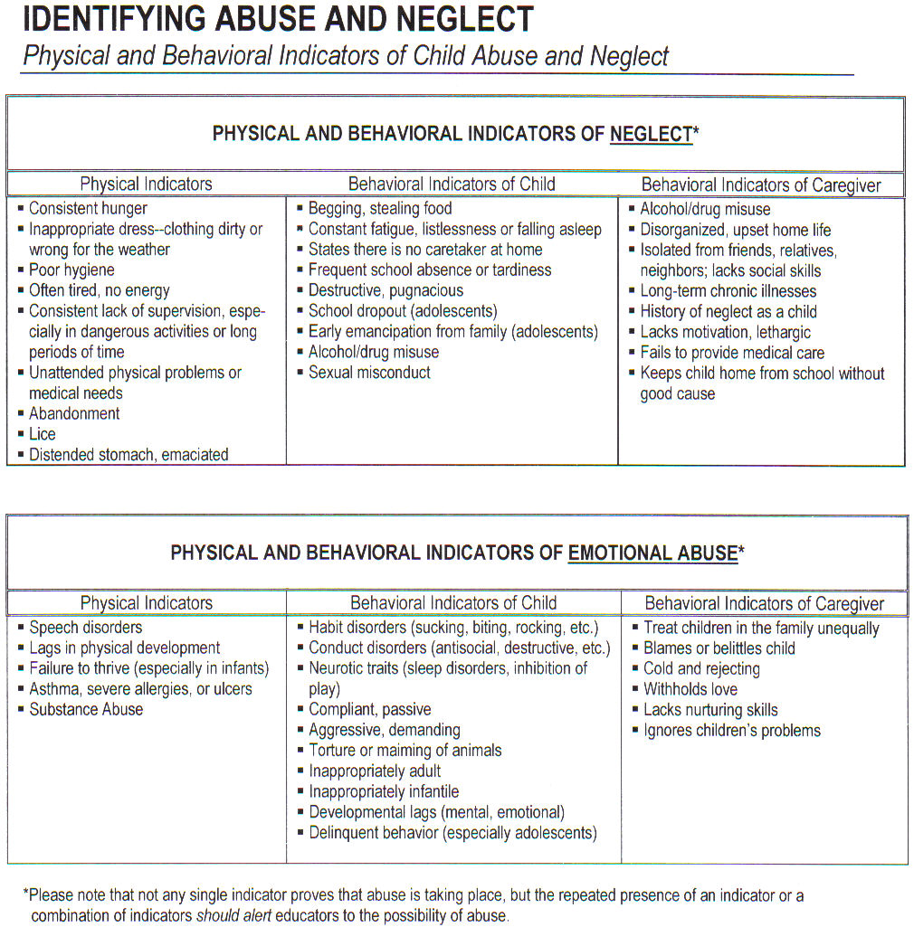

Slide 43
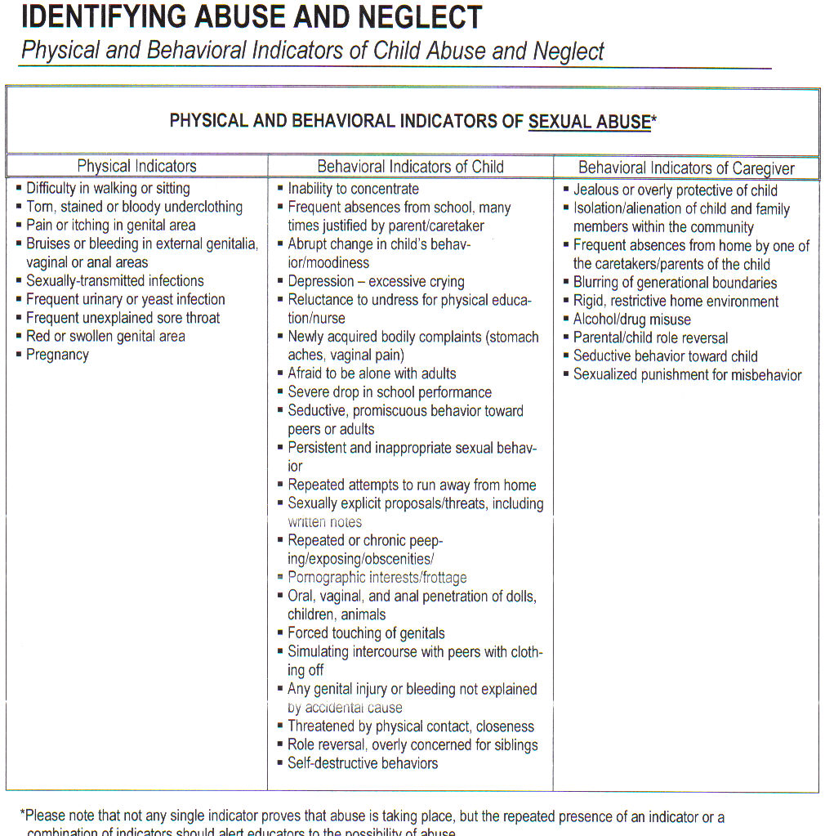

Slide 44
Procedure for Incident Reporting
Lawrence County Cooperative School Policy and Procedure Manual states the following definition for an Incident Report:
“An incident report provides documentation of an incident or occurrence that is not consistent with the routine operation of the facility or routine care/service of clients. It may be an accident or a situation that results in an accident.”
**A copy of an incident reporting is provided to upon hire as well seek your supervisor for any questions you have. (THERE ARE NO DUMB/STUPID QUESTIONS)
Notes:
Most slides include one or more placeholders for titles; body text, such as lists or regular paragraphs; and other content, such as pictures or charts.

Slide 45
DDS Administrative Policy – Incident Reporting
The general purpose of the policy is to establish Departmental procedures for reporting and handling serious incidents/situations that may affect the health and safety of clients, employees, volunteers or visitor’s.
REPORT TO YOUR SUPERVISOR’S IMMEDIATELY!!!!
Incident Report Forms are VERY important to complete accurately and file in timely manner.

Slide 46
Grievance Procedures for Persons Served by the Organization and Personnel
Any violation of an employee’s constitutional rights or statutory rights.
Any violation of an person’s served rights.
Notes:
Type text directly onto the slide within the placeholder.
You can click the slide thumbnails here to navigate among slides.
You can drag the borders of the notes pane to make the notes area bigger.
[Note to trainer: Steps—presented in either numbered or bulleted lists—are always shown in yellow text.]

Slide 47
Individuals Appeals
Each individual/parent/guardian is informed of their rights upon admission and annually thereafter. (some of the things provided are:
  Board Members Listing
  Summary of Funding Sources
  Rules of Conduct & Mission Statement
  Grievance Process for appeals

Slide 48
PERSONNEL APPEALS
It’s Purpose:
is to knowledge employer of a violation of an employees constitutional or statutory rights..
The steps from start to end is indicated under the Grievance Procedure section of Personnel handbook.
It is the employee’s responsibility to read their personnel handbook when given to he/she upon hire.

Slide 49
Procedures for Behavior Management
Behavior Management refers to efforts to modify maladaptive or problem behaviors and to replace them with behaviors that are adaptive and appropriate.
Behavior Management programs must conform to the requirements for effective training or skill development.
Behavior Management policies and procedures are directed to maximizing the growth and development of the individual by incorporating a heirarchy of available methods that emphasize positive approaches; are available in each program area and living unit; are available to individuals and their families and developed with the participation of individuals served.
Lets look more in depth at understanding and supporting behavior:

Slide 50
Behavior Management con’t
Defining: ABC
A . Antecedent
B. Behavior
C. Consequence
The A-B-C model of behavior does provide us with a framework for deciding how behaviors can be modified. It assumes that behavior is influenced by events in the environment. Events that occur immediately before a behavior are called antecedents, and events immediately following a behavior are called consequences. Antecedents may set the occasion for the occurrence of a behavior, and consequences serve to either increase, maintain, or decrease a behavior. Some antecedents can be a sound, a smell, a touch, or the presence of a particular person.

Slide 51
Behavior Management - con’t
Consequences of a positive nature that follows a behavior can include events such as a praise, food, removal of a negative event such as a loud person, or attention. Consequences of a negative nature can be typically unfavorable events, such as a reprimands, or the removal of something positive, such as attention.
Antecedents or cues are those events in the environment that set the occasion for a behavior. All behaviors occur in the midst of a vast array of stimuli, and, although cues do not automatically “make” a response occur, they do communicate the likelihood of reinforcement of a certain behavior.

Slide 52
Behavior Management - con’t
Consequences are those things that follow a behavior that either increases or decrease the probability that the behavior will or will not occur again.
Positive consequences or positive reinforcement is one of the most powerful tools we have to increase behaviors. The use of positive reinforcement is also consistent with the proactive philosophy because it forces programming to focus on what we want the consumer to do.
**A VALUABLE TOOL– always seek your supervisor to learn more about the consumers your are working with.

Slide 53
COMMUNITY INTEGRATION
Its purpose is to view people with developmental disabilities in terms of a lifestyle which provides opportunities for full inclusion in the community setting.
A part of this process will be to review strengths and needs of the individuals while building community integration.

Slide 54
Important Techniques to
Community Integration
Consumer given the experience of choice in both small, everyday matter (what to eat and what to wear) and large, life-defining matters (like who to live with or what sort of work to do).
Personal choices defines and expresses individual identity.

Slide 55
Important Techniques to
Community Integration –cont’d
2. Consumers learn by going into a community and observing what goes on. It sets the stage for any additional need for changes in the skills. (IT A VISUAL TOOL to help consumers get the concept of a goal he/she is working on when in community) for example: utilizing a post office to mail and receive letters.

Slide 56
Legal rights for persons served by the organization
Legal Rights leads us to the list of State and Federal Laws:
P.L. 94-142 Individuals with Disability Education (IDEA) P.L> 99-457 Part H
Rehabilitation Act of 1973 Section 504
Title VI of the Civil Rights Act of 1964
Federal Freedom of Information Act
Developmentally Disabled Assistance and Bill of Rights Act of 1984 and Amendments of 1987
Notes:
Or, you can click the slide thumbnail that you want the slide to follow, and press ENTER instead of clicking New Slide on the shortcut menu.

Slide 57
Legal rights for persons served by the organization
Federal Privacy Act
Americans with Disabilities Act of 1990 P.L. 101-336
P.L. 98-527 Developmentally Disabled Assistance & Bill of Rights Act of 1984
102 of 1972 Handicapped Children’s Act
265 of 1969 AR Mental Retardation Act
Notes:
This placeholder typically has five levels of text indents available, each with its own bullet style and ever-reducing type size. You'll rarely need so many indents, but PowerPoint offers them.

Slide 58
Legal rights for persons served by the organization
(Con’t)
AR Freedom of Information Act
397 of 1975 Child Abuse and Neglect Act
452 of 1983 Adult Abuse
940 of 1985 Guardianship Law
348 of 1985 DHS Reorganization
611 of 1987 Location of Community Homes
Child Maltreatment

Slide 59
Legal rights for persons served by the organization
(Con’t)
Child Safety Seat Use
1050 of 1985 Federal Funds for Child Sexual Abuse
854 of 1987 Exposure to smoke
Notes:
You can also use keyboard methods to position text.
You can turn off Automatic text fit, if you prefer.

Slide 60
Legal Rights for Persons Served by the Organization
There are two other forms that play a very important role when it comes to legal rights for persons served by the organization.
The first form is called the Individual Rights Form and the other is the Civil and Legal Responsibilities.

Slide 61
MEDICATION – implication, side effects, legality of administering medication
As an employee of your LCCS, you may only monitor the consumer taking the medication. The key is that it should always be clear that the person is self-administering their medications. When medication is taken at center/residential. They should be stored in a place that would ensure effectiveness and safety. Locked cabinet with a log maintained daily with prescription name, amount of dosage, how often, and physician prescribing medication. Prescription must be in original container when received. If an competent, adult, needing to take insulin shots. Must bring in an container (toothbrush container). All medications must be locked up immediately and logged when received upon arrival to center/return home.

Slide 62
Lesson 2
Overview of Federal and State Laws
42 U.S.C. 2000a-2000 h-6
Title VI of the Civil Rights Act of 1964
What Is Title VI?
Title VI of the Civil Rights Act of 1964 is a national law that protects persons from discrimination based on their race, color, or national origin in programs and activities that receive Federal financial assistance. If you are eligible for Medicaid, other health care, or human services, you cannot be denied assistance because of your race, color, or national origin.

Slide 63
Overview of Federal and State Laws
Ark. Code Ann. 6-41-201-6-41-22
102 of 1972 Handicap Children’s Act
It shall be the policy of this state to provide and to require school districts to provide, as an integral part of the public schools, a free appropriate public education for students with disabilities. The State Board of Education is therefore expressly authorized to assign responsibility for providing free appropriate public education of any child with a disability to an appropriate school district.

Slide 64
Overview of Federal and State Laws
20 U.S.C. 14000 et. Seq (Part B and Part H)
P.L. 94-142
Individuals with Disability Education (IDEA)
P.L. 99-457 Part H
Type and purpose: An education act to provide federal financial assistance to State and local education agencies to guarantee special education and related services to eligible children with disabilities.
Who is protected? Children ages 3-21 who are determined by a multidisciplinary team to be eligible within one or more of 12 specific disability categories and who need special education and related services.

Slide 65
Overview of Federal and State Laws
29 U.S.C. 706 (8), 794-794b
Rehabilitation Act of 1973 Section 504
Type and Purpose: A civil rights law to prohibit discrimination on the basis of disability in programs and activities, public and private, that receive federal financial assistance.
Who is protected? Any person who (1) has a physical or mental impairment that substantially limits one or more major life activities, (2) has a record of such an impairment or (3) is regarded as having such an impairment. Major life activities include walking, seeing, hearing, speaking, breathing, learning, working, caring for oneself and performing manual tasks.

Slide 66
Overview of Federal and State Laws
5 U.S.C 552a
Federal Privacy Act
Records maintained on individuals
No agency shall disclose any record which is contained in a system of records by any means of communication to any person, or to another agency, except pursuant to a written request by, or with the prior written consent of, the individual to whom the record pertains.

Slide 67
Overview of Federal and State Laws
42 U.S.C. 6000-6083
P.L. 98-527
Developmentally Disabled Assistance and Bill of Rights Act of 1984
The Developmental Disabilities (DD) Act of 1984 (P.L.98-527) allows for federal monies to be made available to the states to assist in providing comprehensive services and advocacy assistance to persons up to age 21 with developmental disabilities. In 1987, the bill was reauthorized by Congress and expanded to require that states designate certain priority areas and expend a portion of their cash allotment to fulfill these designated priority areas. Under the Act each state receives federal funds.

Slide 68
Overview of Federal and State Laws
Ark. Code Ann. 28-65-101-28-65-109
940 of 1985
Guardianship Law
A guardian is a person appointed by a court to have the care and custody of the person or of the estate, or of both, of an incapacitated person. An incapacitated person is a person who is impaired by reason of disability such as mental illness, mental deficiency or physical illness to the extent of lacking sufficient understanding or capacity to make or communicate decisions to meet the essential requirements for his health or safety or to engage his estate. An incapacitated person for whom a guardian has been appointed is not presumed to be incompetent and retains all legal and civil rights except those which have been expressly limited by court order or have been specifically granted by order to the guardian by the court. It is the duty of the guardian of the person to care for and maintain the ward, and if he or she is a minor, to see that they are properly trained and educated and that opportunities are afforded to the individual. The guardian of the person may be required to report the condition of his or her ward to the court, at regular intervals or otherwise, as the court may direct. All guardians must file an annual report with the court. The report shall contain the person's current mental, physical and social condition; his present living arrangements; the need for continued guardianship services; and any other information requested by the court or necessary in the opinion of the guardian. A guardian is required to obtain court approval in order to make certain decisions. Among those are: consent on behalf of the incapacitated person to abortion, sterilization, psychosurgery or removal of bodily organs except when necessary in a situation threatening the life of the incapacitated person, and consent to withholding life-saving treatment. The qualifications of guardian are they must be a resident of This state, eighteen (18) or more years of age, of sound mind, and not a convicted and unpardoned felon. The Arkansas Department of human services or any charitable organization is qualified for appointment as guardian of the person and estate of a minor:
1. When the major portion of the support of the minor is being supplied or administered by the department or organization;
2 .When the court finds that the minor has been abandoned by his parents;
3. When his or her parents are incapacitated or unfit for the duties of guardianship. A bank or similar institution with trust powers may be appointed guardian of the estate of an incapacitated person. The parents of an unmarried minor, if qualified, and in the opinion of the court, suitable, shall be preferred over all others for appointment as guardian of the person. In order to be appointed guardian of a person and his estate, it is necessary to file a petition with the probate court setting forth the grounds justifying the appointment. The cost associated with such petition will include a filing fee and attorney's fees. It is necessary for the court to hold a hearing before appointing a guardian. The type, scope and duration of the guardianship will be set forth in the petition. The determination of incapacity must be established by one or more qualified professionals. A professional evaluation shall be performed prior to the court hearing. The evaluation shall include the mental and physical condition of the ward, his adaptive behavior and intellectual functioning. If no professional evaluation performed within the last six (6) months prior to petitioning the court is available, the court will order an independent evaluation. There are several less restrictive alternatives to guardianship which should be explored. Yet, alternatives will not always be preferable to guardianship. If impairments are severe, no advance planning has been done, and/or court supervision is clearly: needed, guardianship may be the best course of action. One alternative is the power of attorney in which individuals are allowed to name agents to act on their behalf if they become incapacitated. Conservatorship for the disabled and custodial trusts are typical1y used for people with disabilities. A conservatorship is, in effect, a voluntary form of guardianship of the estate. Since the person over whom the conservatorship is sought must consent, this procedure is not available to a mentally incapacitated person. A custodial trust is a method by which persons with few assets may make a trust for the benefit of an incapacitated person. There are some disadvantages of guardianship. The appointment of a guardian is predicated upon a judicial determination of capacity and therefore it results in a substantial loss. Establishing a guardianship can be expensive. Consideration must be given to court fees, lawyers, a doctors who are involved

Slide 69
Overview of Federal and State Laws
Ark. Code Ann. 5-28-101-5-28-109
452 of 1983
Adult Abuse
The General Assembly recognizes that the state must provide for the detection, correction, and prosecution of the maltreatment of adults.
It shall be unlawful for any person or caregiver to abuse, neglect, or exploit any endangered or impaired person subject to protection under the provisions of this chapter.

Slide 70
Overview of Federal and State Laws
Ark. Code Ann. 25-19-101-25-19-107
Arkansas Freedom of Information Act
It is vital in a democratic society that public business be performed in an open and public manner so that the electors shall be advised of the performance of public officials and of the decisions that are reached in public activity and in making public policy. Toward this end, this chapter is adopted, making it possible for them, or their representatives to learn and to report fully the activities of their public officials.

Slide 71
Overview of Federal and State Laws
Ark. Code Ann. 12-12-501-12-12-515
(1) Provide a system for the reporting of known or suspected child maltreatment;
(2) Ensure the immediate screening, safety assessment, and prompt investigation of reports of known or suspected child maltreatment;
(3) Ensure that immediate steps are taken to:
(A) Protect a maltreated child and any other child under the same care who may also be in danger of maltreatment; and
(B) Place a child who is in immediate danger of severe maltreatment in a safe environment;
(4) Provide for immunity from criminal prosecution for an individual making a good faith report of suspected child maltreatment;
(5) Preserve the confidentiality of all records in order to protect the rights of the child and of the child's parents or guardians;
(6) Encourage the cooperation of state law enforcement officials, courts, and state agencies in the investigation, assessment, prosecution, and treatment of child maltreatment; and
(7) Stabilize the home environment if a child's health and safety are not at risk.
Child Maltreatment

Slide 72
Overview of Federal and State Laws
Ark. Code Ann. 20-78-215
1050 of 1985
Federal Funds for Child Sexual Abuse
By the enactment of this section, it is the specific intent of the General Assembly to ensure that the State of Arkansas may qualify for the maximum amount of federal funds made available through Pub. L. 98-473 or any subsequent and related federal legislation enacted for use in reducing the incidence of child sexual abuse.
Specifically, regulations promulgated by the Director of the Department of Human Services pursuant to this section may address federally mandated requirements for employment history and background checks and nationwide criminal record checks, as may be necessary in accordance with the provisions of Pub. L. 92-544, for all operators, staff, or employees, or prospective operators, staff, or employees of the child care facilities or programs as defined in this section.
(b) In order to enable the State of Arkansas to fully participate and share in federal funds made available to the states through the Social Services Block Grant Act, or otherwise for the purposes of reducing and eliminating the incidence of child sexual abuse in child care facilities, as defined in § 20-78-202(4), the director is authorized at his or her discretion to promulgate, pursuant to the Arkansas Administrative Procedure Act, § 25-15-201 et seq., rules and regulations implementing such federal requirements as may be placed upon the states to qualify for the funds.
(c) Persons, other than the State of Arkansas, shall not acquire actionable right by virtue of this section.

Slide 73
Overview of Federal and State Laws
U.S.C. 12101 et. Seq.
American’s with Disabilities Act of 1990
P.L. 101-336
Type and Purpose: A civil rights law to prohibit discrimination solely on the basis of disability in employment, public services and accommodations.
Who is protected? Any individual with a disability who: (1) has a physical or mental impairment that substantially limits one or more life activities; or (2) has a record of such impairment; or (3) is regarded as having such an impairment. Further, the person must be qualified for the program, service or job.

Slide 74
Post Test
What does the DDS Standards state that an employee must have to be in compliance with training hours? Answer: 12 hours of training or more based on job title of training annually and also an annual review of topics that are specified by DDS.
How often must an employee’s First Aid Certification be renewed? Answer: every three years but will be renewed as cpr is being renewed every 2 yrs (american heart association)
Please describe the purpose of an incident report. Answer: to be in compliance with DDS standard
Who should file a grievance? Answer: Employee/Consumer
What does the phrase “Behavior Management” mean?
Answer: ABC A . Antecedent B. Behavior C. Consequence

Slide 75
Post Test
7) Please list 3 State and Federal Laws and give a brief description of the three you chose: a)______________________________________ answers: see above for answer
b)______________________________________
c)______________________________________
8) What prevention strategies should you utilize when coming into contact with blood borne pathogens? answers: see above for answer
9) What is PHI? answers: protected health information
10) True or False LCCS can just accept anyone into DDTCS program
11) What does DDTCS stand for?
answer: Developmental Day Treatment Clinic
WE ARE A MEDICAL CLINIC
Notes:
This lesson will provide some tips on just how you insert those extra graphical elements—pictures, charts, and tables—onto slides.

